Slide 1


Exploratory data Analysis on layoffs dataset - sQl project
Presented by, Aarthi Duraisingam

Slide 2
About the Dataset:
This Layoff dataset Consists of layoff details of around 1600 companies from March’2020 to March 2023. Objective:
Our aim of this project is to do thorough Explanatory Data Analysis(EDA) on layoffs & finding the key insights through various dimensions. Source File:
The file is in excel format(File Name: layoffs.xlsx) of columns company, location, industry, total laid-off, percentage laid-off, date, stage, country & funds raised in millions.

Slide 3
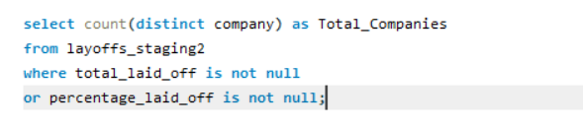

Q1: Calculate the total no. of companies, that undergoes Layoffs.
INSIGHTS:
* There were 1628 companies in total, which undergone layoffs from March 2020 to March 2023 as per the dataset.

Slide 4


Q2. Total No. of companies in which 100% laid off happened
INSIGHTS:
* There were 116 companies in total, Where 100% laid off took place.

Slide 5
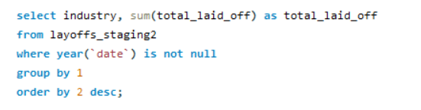
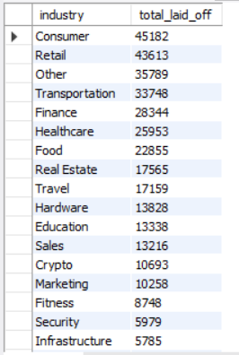
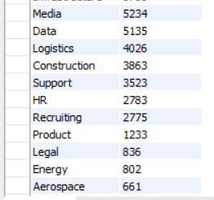
Q3. Find the industry & total_laid_off
INSIGHTS:
* From year 2020 till 2023, Total laid off counts are highest in the Consumer Industry, followed by Retail, Others & Transportation & so on.

Slide 6
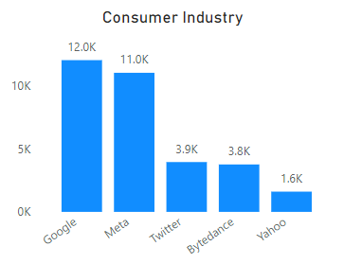
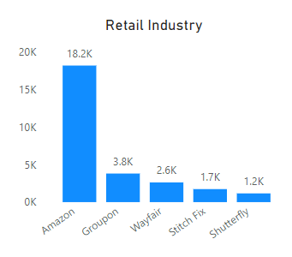
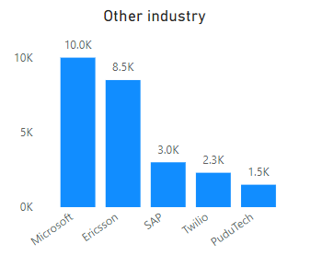
Industry-wise TOP 5 Layoff companies
* Consumer Industry has the highest total Laid off with 45,182 count out of which Google ranked No1 with Layoff count of 12,000, followed by Meta,Twitter& so on.
* Amazon ranked No1 in Retail Industry with highest layoff count as 18.2k.
* Microsoft & Ericsson has the layoff counts of 10k & 8k in Other Industry Category.

Slide 7
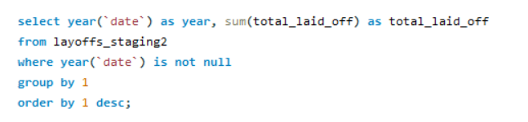
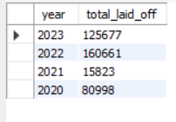
Q4. Find the Total_laid_off by Each Year

Slide 8
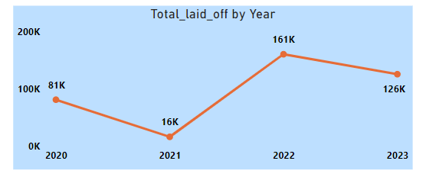
Year-wise Total_laid_off
INSIGHTS:
* In 2022, the layoff count peaked at the highest level of 160,000 among all the years. However, the year 2023 has seen an almost 125,000 layoff count based on the data available for the first three months, suggesting that it could potentially surpass the peak if the trend continues until December 2023.

Slide 9
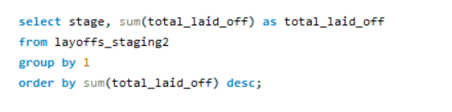
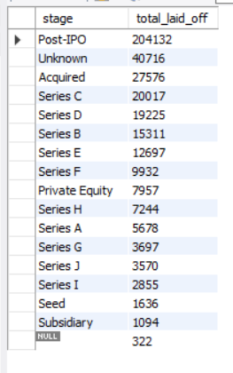
Q5. Find the Total_laid_off count by each stage
INSIGHTS:
* 204k people were laid off during the post-IPO stage. This occurred due to cost-cutting actions taken by companies as they transitioned from private to public status in the stock market.

Slide 10
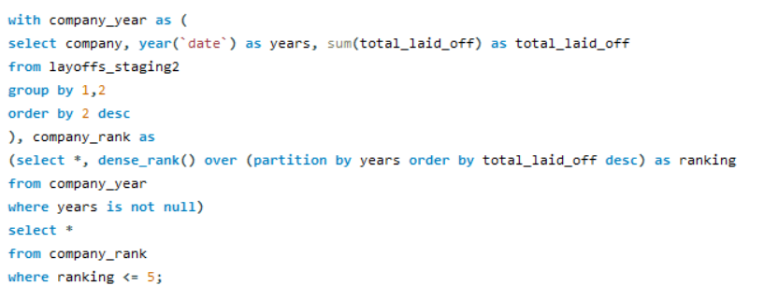
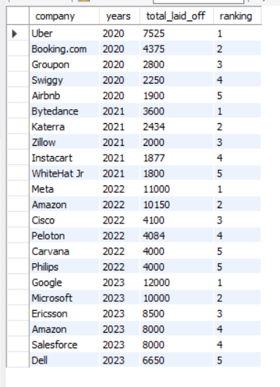
Q6. Calculating top 5 company based on total Layoff for each year
INSIGHTS:
* In 2020, data shows that most layoffs were in the Transportation & travel industry due to the widespread impact of the coronavirus pandemic affecting countries worldwide. Subsequently, from 2021 onwards, layoffs occurred not only in the consumer and retail industries but also in other sectors.

Slide 11

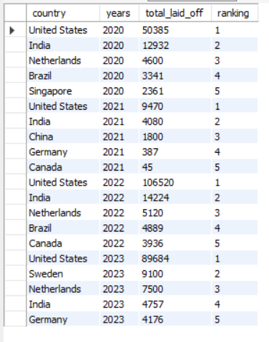
Q7. Calculating top 5 country based on layoff total for each year
INSIGHTS:
* For subsequent years from 2020 to 2023, United States ranked No1 country in Layoffs.

Slide 12
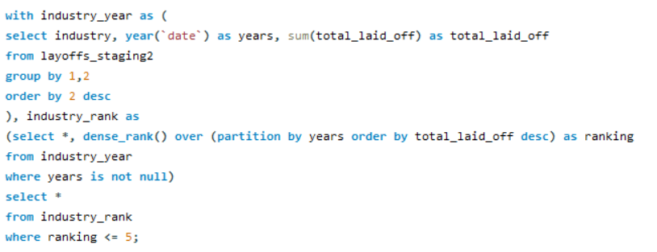
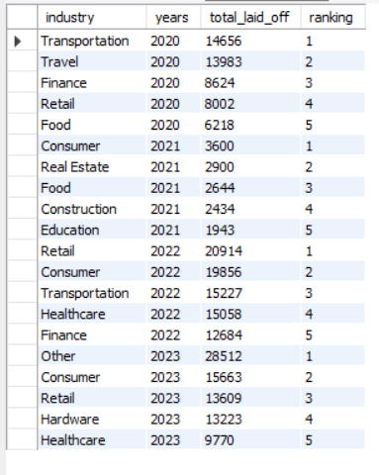
Q8. Calculating top 5 industry based on layoff total for each year

Slide 13
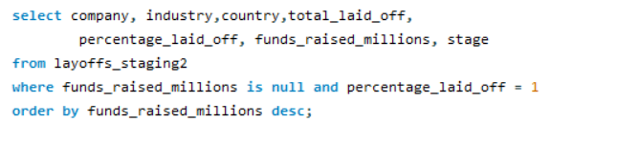
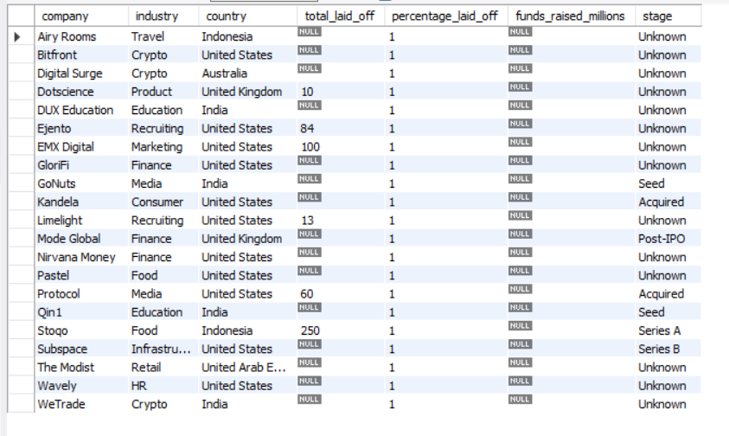
Q9. Find the no. of companies that doesnot raise any Funds/ unknown and 100 % layoff.
INSIGHTS:
* There are 21 Companies in total, where 100% laid-off happened & the funds raised is Unknown & most of them are from US & India.

Slide 14
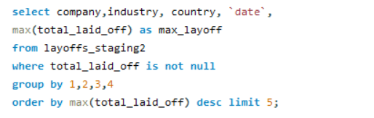
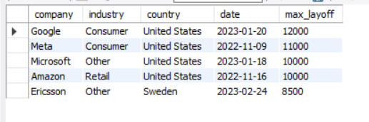
Q10. Find the top 5 mass layoff companies within a day
INSIGHTS:
* Mass layoffs took place in the months of November 2022 and January 2023 at Google, Meta, Microsoft, and Amazon in the United States, with each company laying off more than 10,000 people within a day.

Slide 15
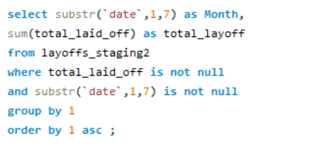
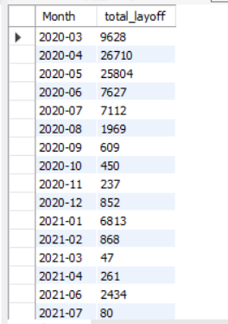
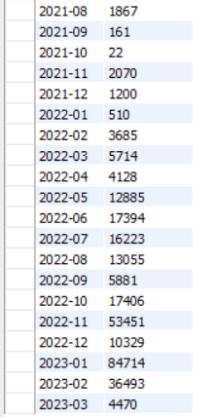
Q 11. Calculate THE total layoff, each month of the year in ascENDING order

Slide 16
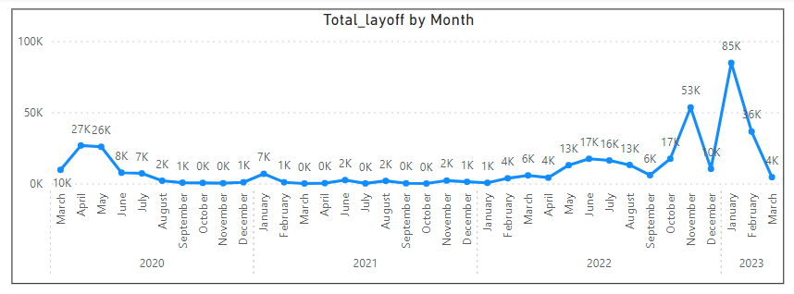
Month-wise Layoffs – Mar’2020 – Mar’2023
INSIGHTS:
* Mass layoffs took place in the months of November 2022 and January 2023 with Layoff counts of 53K and 85K.

